Slide 1
Mini Project Data Science Analysis of Traffic Conditions in Bandung City using Waze Data
by Adrian Maulana Muhammad
https://github.com/adrn-mm/DSLS_Mini-Project-DS_Adrian-Maulana-Muhammad

Slide 2
Table of Contents
Business Understanding
Data Understanding
Data Description & Pre-processing
Exploratory Data Analysis (EDA)
Machine Learning Model - Clustering
Summaries & Recommendations
References

Slide 3
Business Understanding
I

Slide 4
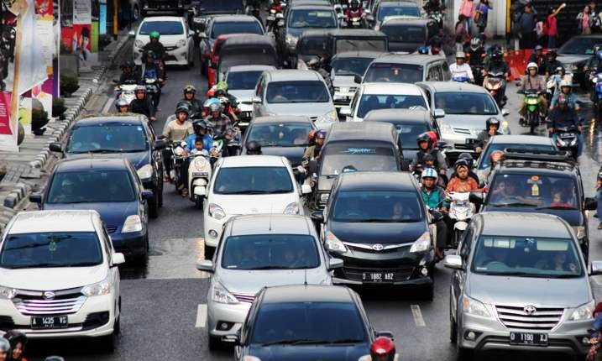
Visitors in Bandung City
Based on an analysis of visitor data for cities in West Java province provided by Open Data Jabar, Bandung has the highest number of visitors and a positive trend in visitor growth over the last two years. This phenomenon may impact traffic conditions on all roads in Bandung. By utilizing traffic data provided by Waze for Cities, we can analyze the traffic conditions in Bandung, including information on traffic jams, irregularities, and alerts.

Slide 5
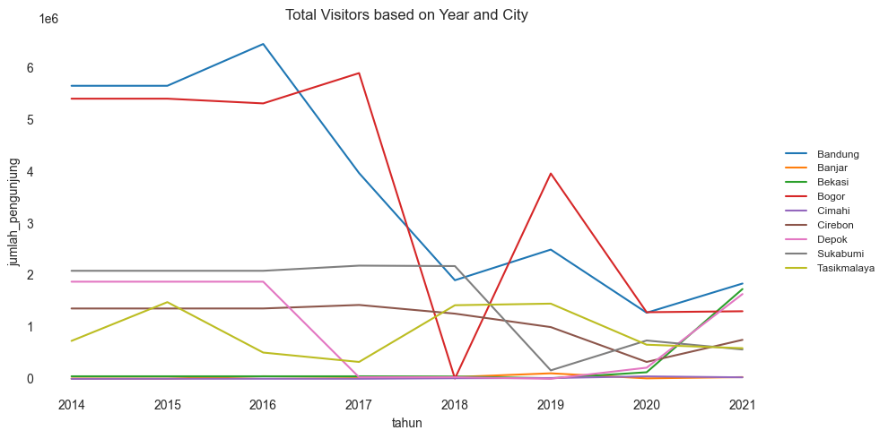
Total Visitors based on Year and City
The chart below shows that Bandung has a positive trend in visitor growth over the last two years.
Source: Open Data Jabar

Slide 6
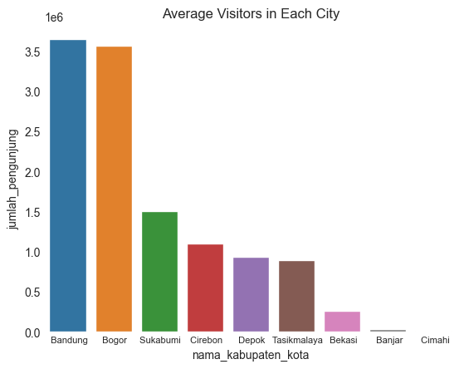
Average Total Visitors in Each City
The chart below shows that Bandung has the highest number of visitors.
Source: Open Data Jabar

Slide 7
Problem Description
I have identified several summary questions to address the problem from the background information provided:
What are the traffic alert patterns in Bandung City?
How is the pattern and distribution of traffic congestion in Bandung City?
How can we group Bandung City areas with similar traffic characteristics?

Slide 8
Project Goals
To answer this question, I set the goals and methods that can answer the problem.
Analyze the traffic alert pattern in the city of Bandung using Waze for Cities data analysis to see the most dominant type of alert.
Analyzing traffic congestion patterns in Bandung by analyzing Waze for Cities data for Bandung in various circumstances.
Conducting a Machine Learning algorithm, which is clustering, to get a pattern of group division for roads in Bandung with similar traffic characteristics.

Slide 9
Data Understanding
II

Slide 10

Waze for Cities Data
Through the Waze for Cities initiative, which involves a data-sharing partnership between Waze and public sector partners worldwide, we can utilize the data to analyze traffic safety in Bandung City for visitors.

Slide 11
Data Summaries
Data | Summary
Aggregate Alerts | This data provides information on the number and types of incident reports sent by Waze users within a specific area during a certain period of time. This data can be helpful for road users and public service providers identify incidents affecting traffic and mobility in a particular area.
Aggregate Median Irregularities | This data provides information on the condition of roads, particularly in terms of irregularities on the road surface. This data can assist public service providers in monitoring road conditions and planning for repairs.
Aggregate Median Jams | This data provides information on traffic congestion on a particular road during a certain period of time. This data can assist road users in planning more efficient travel routes and avoiding traffic congestion.

Slide 12
Data Description & Pre-processing
III

Slide 13
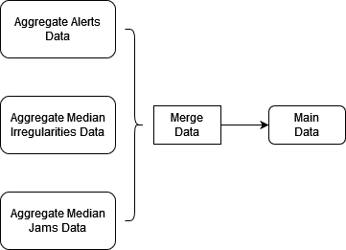
Denormalized Data

Slide 14
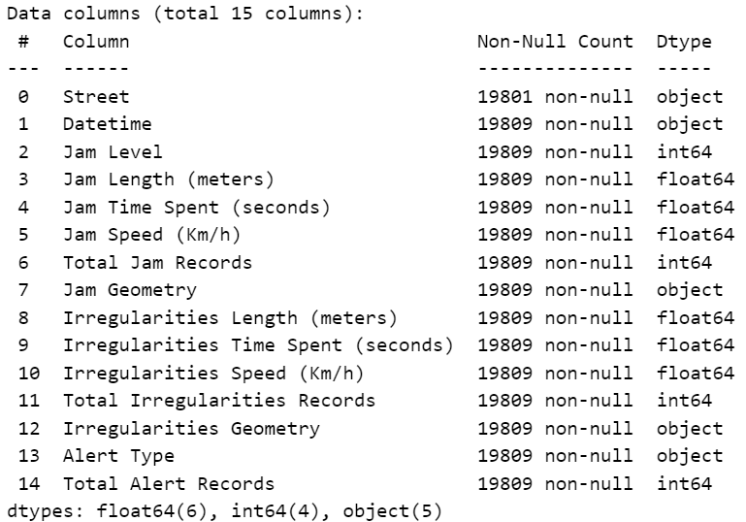
Data Shape & Data Types
The main data has 15 columns and 19.809 rows
The list of data types is as follows, I will convert the Datetime column to the DateTime type.

Slide 15
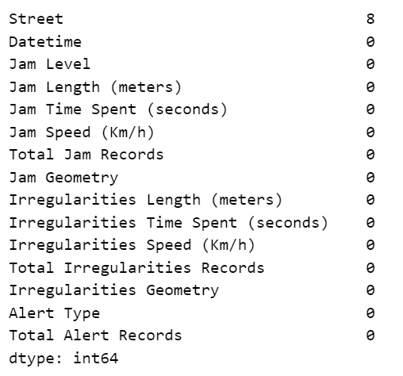
Checking Missing Values
Since there are only eight rows with missing values out of 19.809 rows, I will drop those rows with missing values.

Slide 16
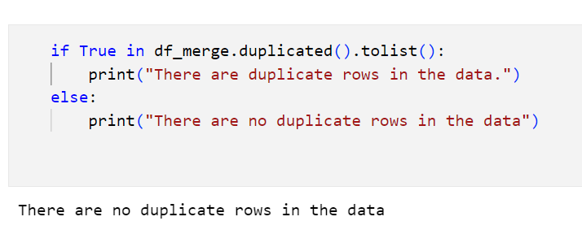
Checking Duplicate Rows
There are no duplicate rows in the main data

Slide 17
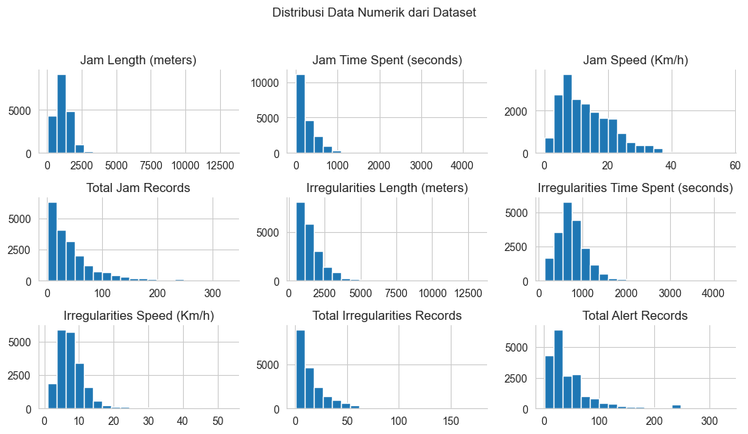
Checking Data Distribution for Numerical Data
Most of the numerical data on the dataset has a skewed distribution.

Slide 18
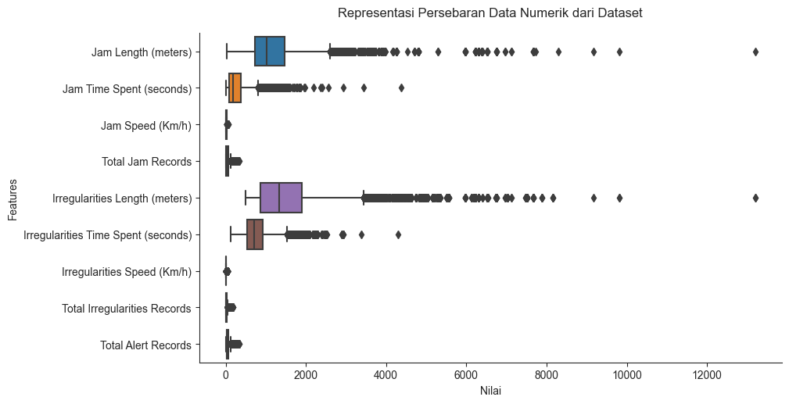
Checking Outliers in Numerical Data
Most of the dataset has outliers, but the outliers pattern in the Jams and Irregularities columns is almost the same. So there is a possibility that these outliers are not an unusual error or condition, so I will not delete the outliers for now because the outliers can be aware of the conditions in the dataset. But, I will remove the outliers before the Machine Learning Stage.

Slide 19
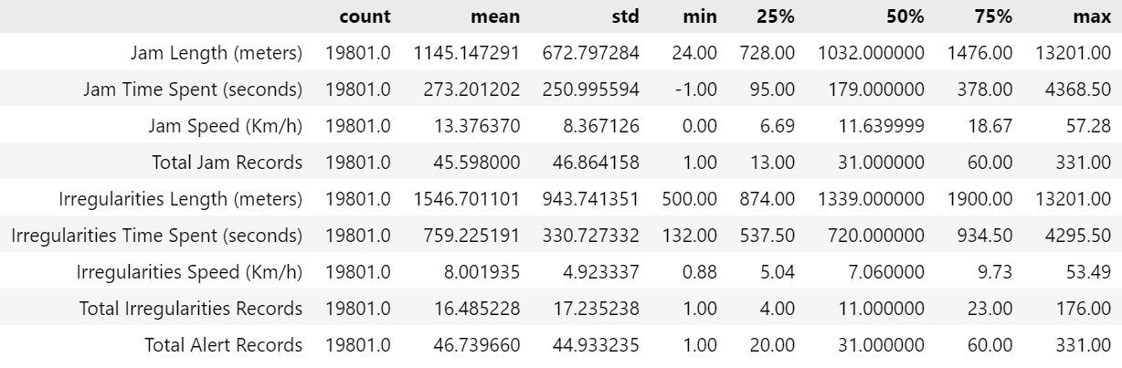
Checking Descriptive Statistics

Slide 20
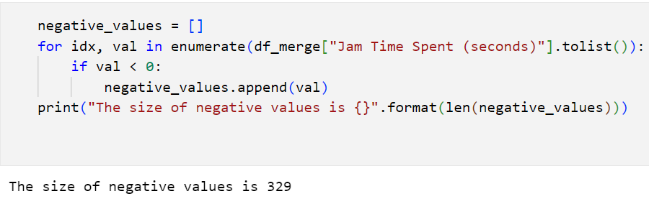
Checking Negative Values
There are many negative values in the Jam Time Spent (seconds) column. This negative value means that traffic in the area does not experience delays or even faster than normal speed. In the context of data delay of hours, negative values indicate the remaining time, which is the difference between the time needed to pass the road and the actual time needed. So that this negative value is not an error or an unusual thing, I do not delete this negative value.

Slide 21
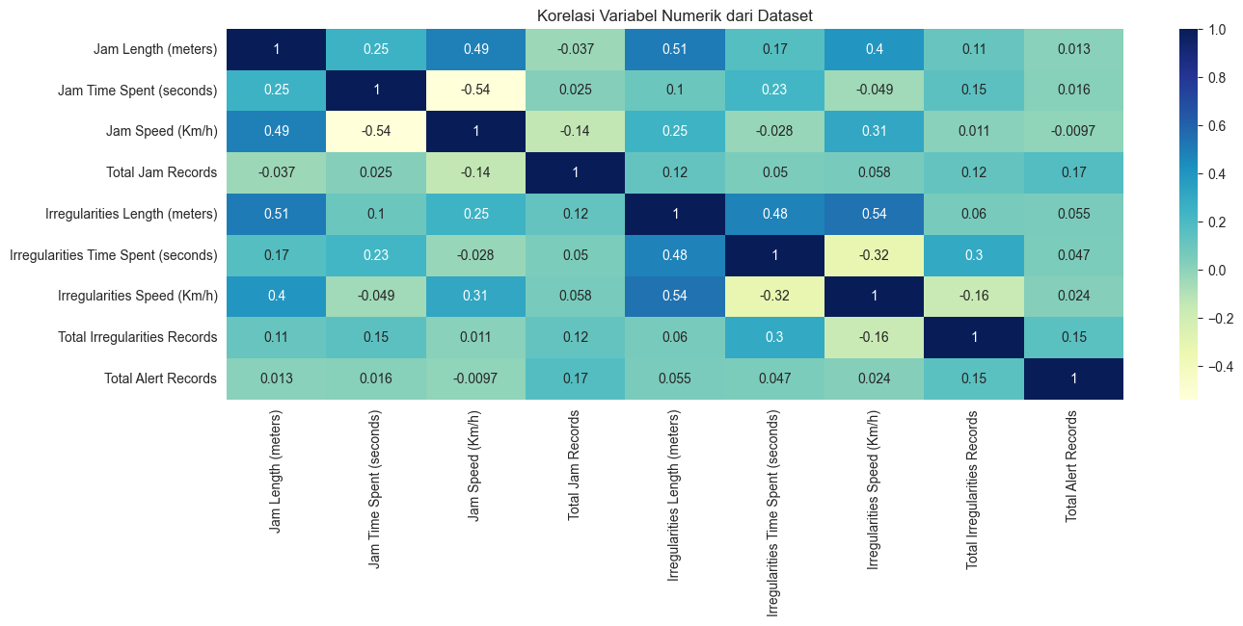
Checking Correlation in Numerical Data
The time, distance, and speed column in Jams and Irregularities data appears to have a moderate positive correlation.

Slide 22
Exploratory Data Analysis (EDA)
IV

Slide 23
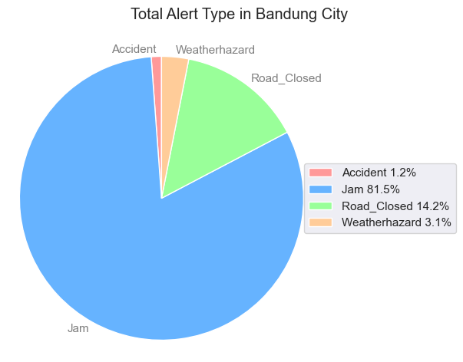
Alert Type Proportion in Bandung City
As we can see from the chart below, the most frequently reported Alert Type by drivers in Bandung City is traffic jam.

Slide 24
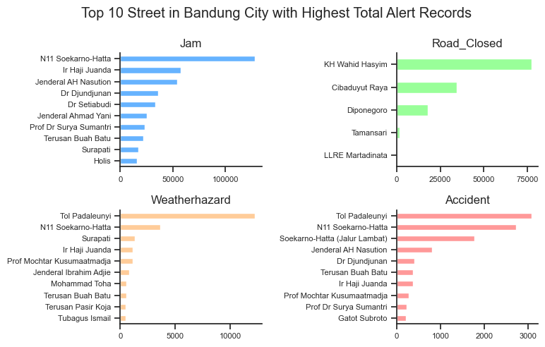
Street in Bandung City with Highest Alert Reports

Slide 25
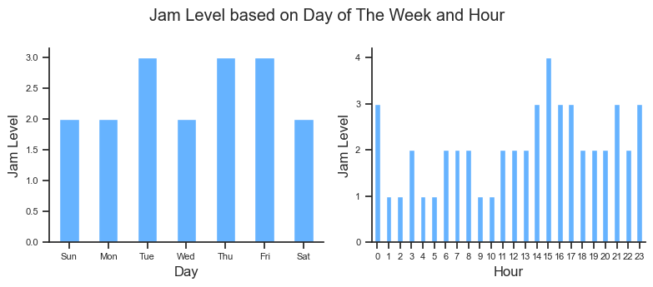
Jam Level Based On Day of The Week & Hour
It is noticeable that the average traffic congestion is quite severe on Tuesdays, Thursdays, and Fridays. Meanwhile, traffic congestion tends to increase from 9 a.m. to 3 p.m.

Slide 26
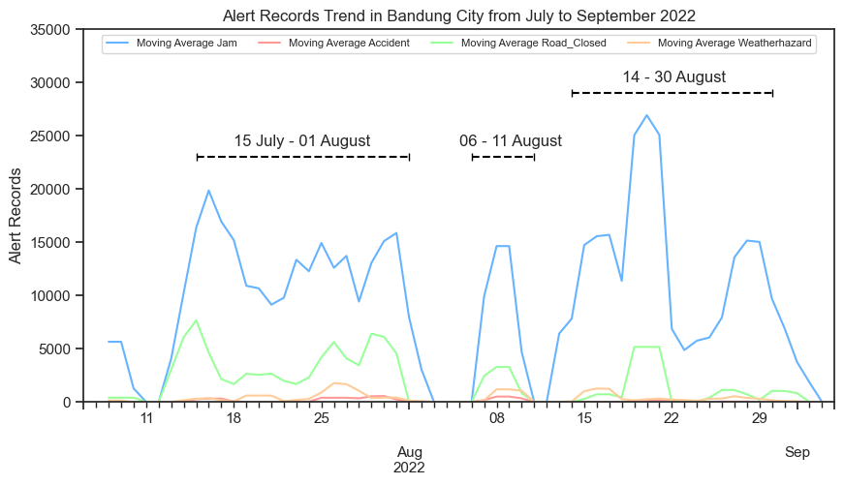
Alert Records Trend
There are three time periods from July to September 2022, where the trend for each alert report has significantly increased. A further diagnostic analysis is needed to determine the causes of these trends during these periods.

Slide 27
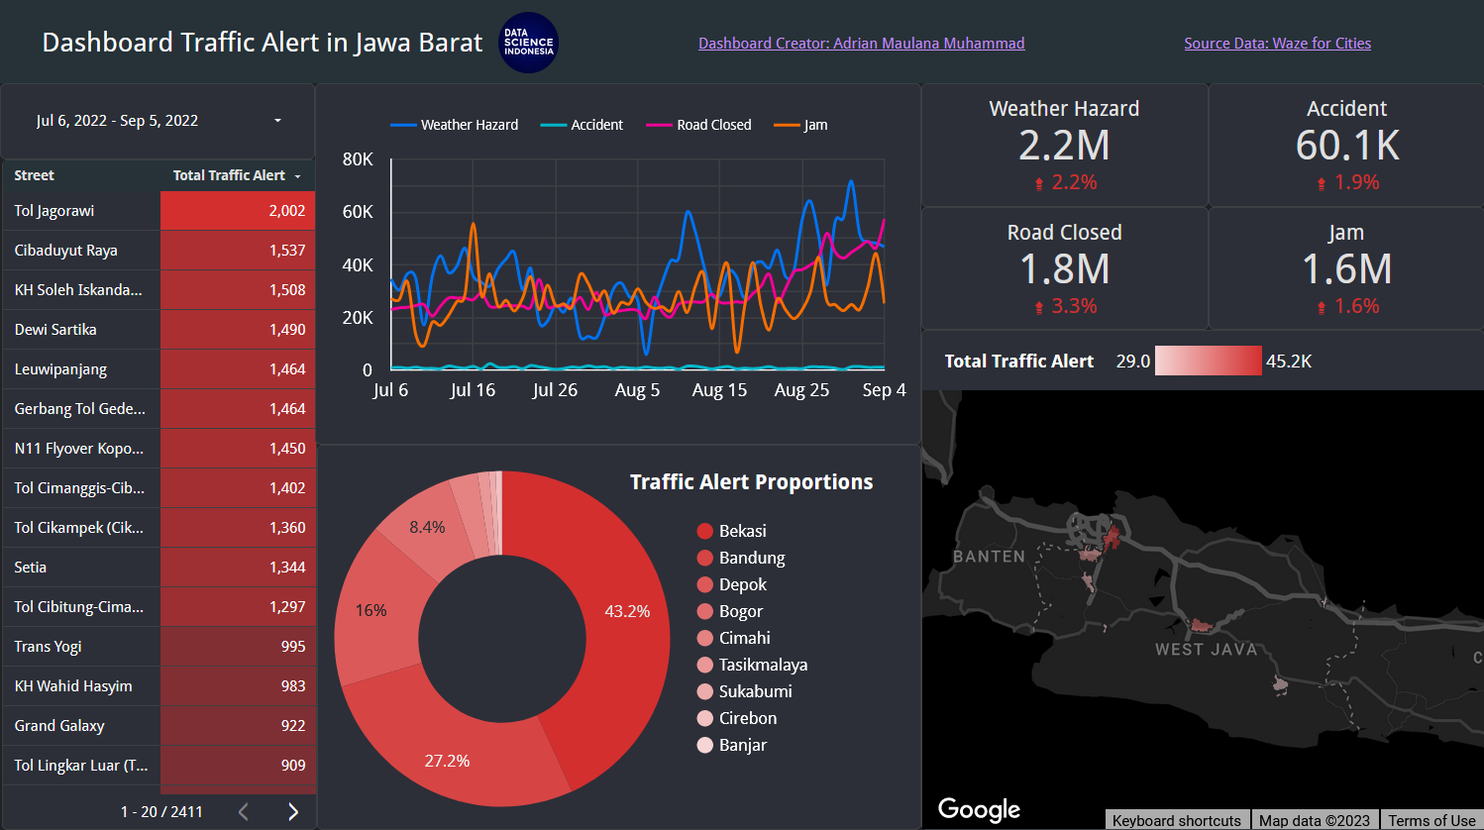
Analytics Dashboard
This analytics dashboard shows the proportion of traffic alerts in the city and street of West Java. The local government can use the dashboard to monitor and get insight into their area's traffic condition. The dashboard can be accessed at this link.

Slide 28
Machine Learning Model - Clustering
V

Slide 29
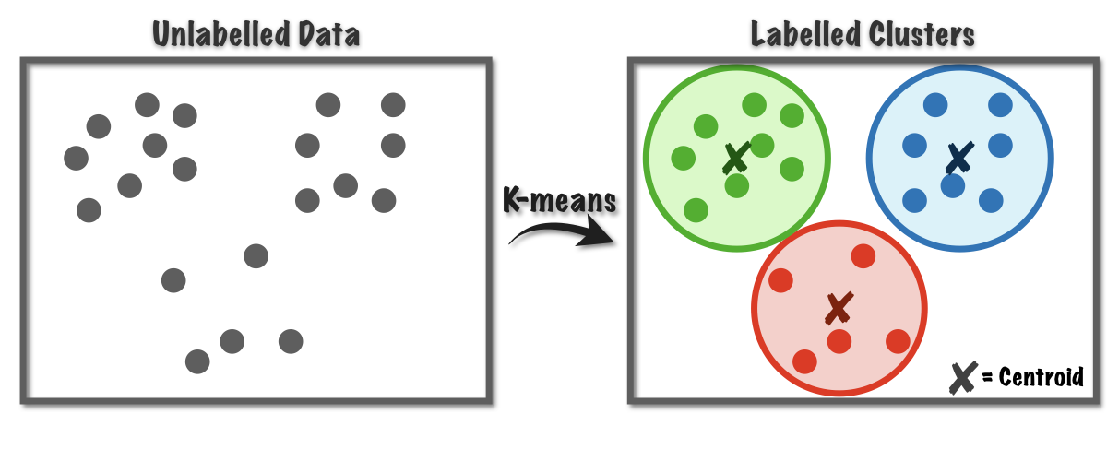
K-Means Algorithm
At this stage, we will group or clustering street in Bandung City based on data length, time spent, and speed for irregularities in traffic. The clustering algorithm that I chose is K-Means. K-means clustering is a type of unsupervised learning used with unlabeled datasets. The goal of this algorithm is to find K groups in the data. The algorithm works iteratively to assign each data point to one of K groups based on the provided features. Data points are clustered based on feature similarity.

Slide 30
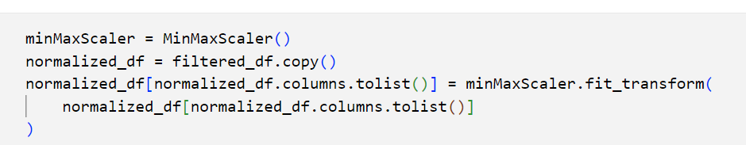
Feature Scaling
Feature scaling is a common preprocessing step in machine learning that is often performed before applying the k-means clustering algorithm. The reason for performing feature scaling is to ensure that all features or variables have equal importance in the clustering process, regardless of their original scale or units of measurement.

Slide 31
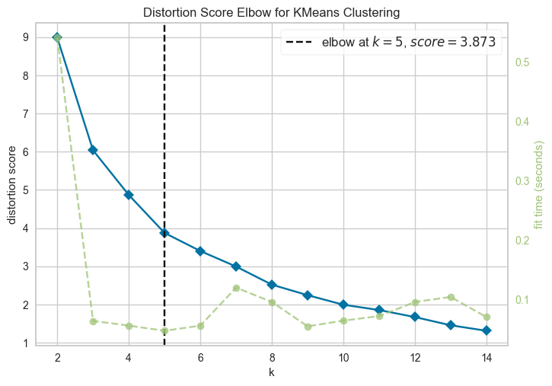
Elbow Method
The elbow method is commonly used to determine the optimal number of clusters in K-Means clustering. The optimal number of groups is where the "elbow" of the curve is located in the plot. The below graph selects an Elbow point at K=5. Let’s validate the value of K using the Silhouette plot.

Slide 32
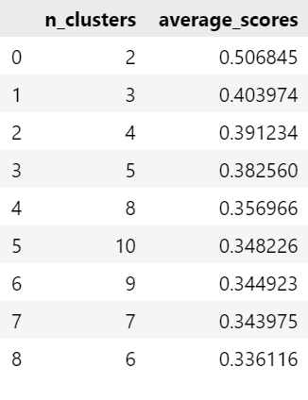
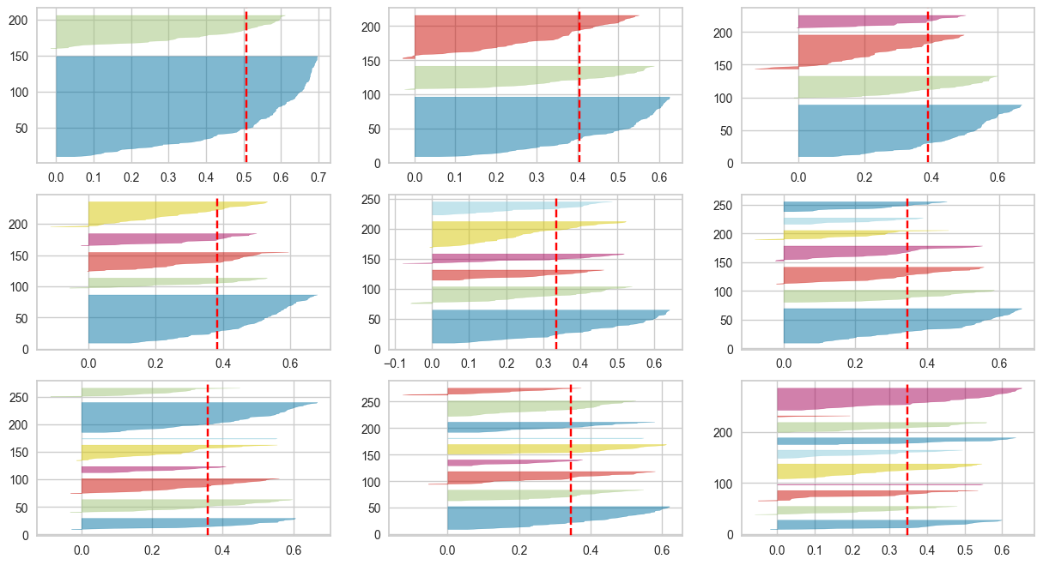
Silhouette Score
Silhouette score is a widely used metric for evaluating the quality of clusters in K-Means clustering. The Silhouette score ranges from -1 to 1, where a score of 1 indicates good clustering, and a score of -1 indicates poor clustering.

Slide 33
Choosing K=4
The Silhouette score is maximum (0.50) for K = 2, but that’s not sufficient to select the optimal K. The following conditions should be checked to pick the right ‘K’ using the Silhouette plots:
For a particular K, all the clusters should have a Silhouette score more than the average score of the dataset (represented by a red dotted line). The x-axis represents the Silhouette score.
There should not be wide fluctuations in the size of the clusters. The width of the groups represents the number of data points
The value of 4 for clusters looks optimal. The silhouette score for each group is above average silhouette scores. Also, the thickness is more uniform than the plot with a bunch of 2 or 3, with one cluster thickness much more than the other. Thus, one can select the optimal number of groups as 4.

Slide 34
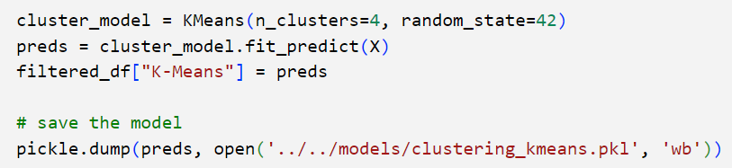
Fitting K-Means with K=4
After determining the optimal value of K, the next step is to perform the process of fitting the K-Means model to the features of the data. In this step, the K-Means algorithm is applied to the data, and the model is trained to cluster the data points into K clusters. Once the model is fitted to the data, it can be used to predict the cluster labels of new data points based on their proximity to the centroids.

Slide 35
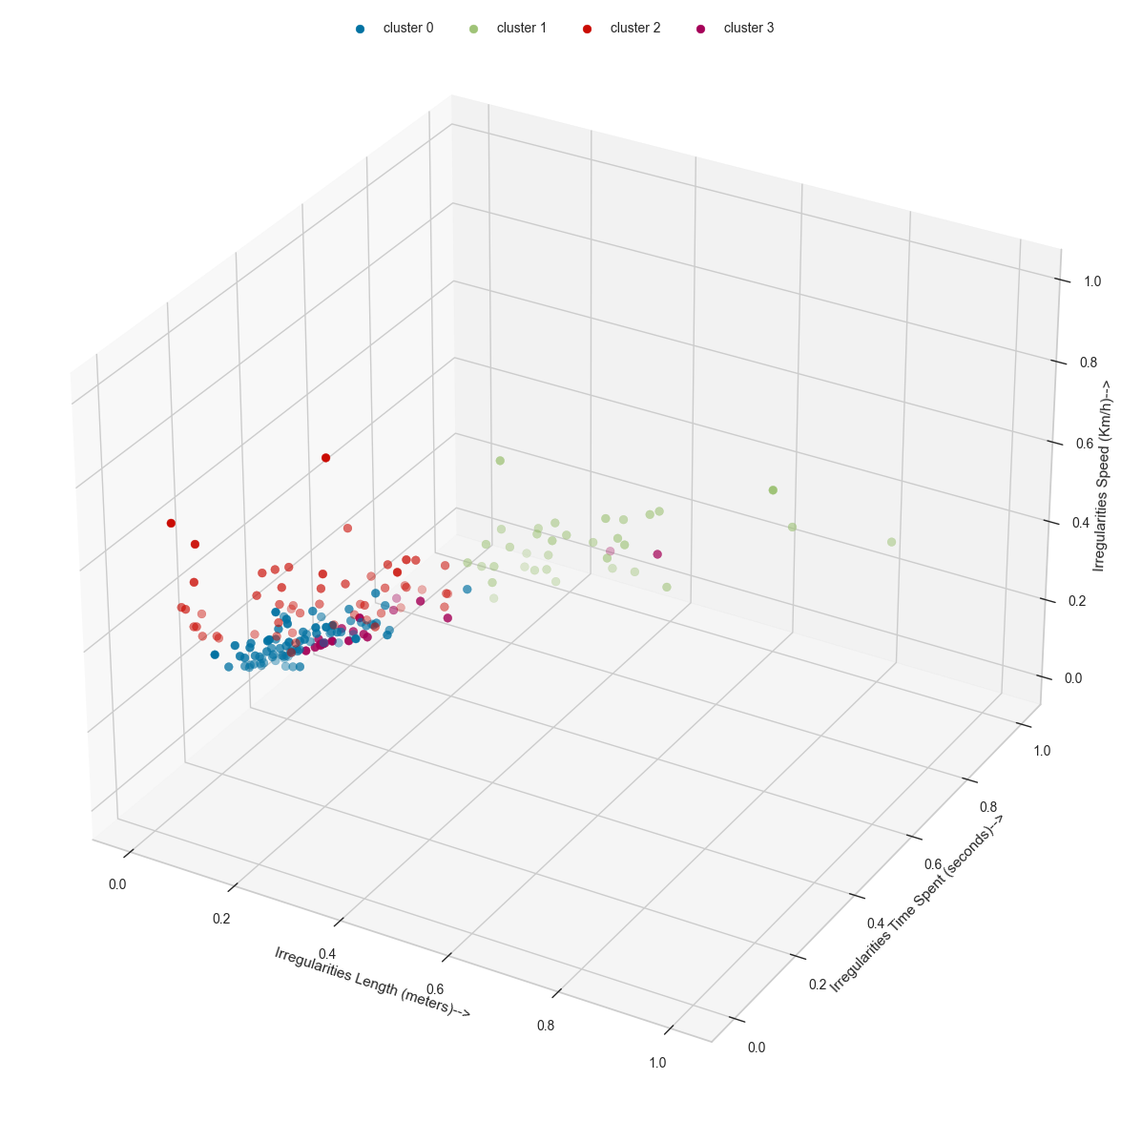
Clusters Visualization
The previous K-Means cluster prediction results can be visualized in a three-dimensional chart shown below. This visualization allows for a deeper understanding of the clustering structure and pattern of the data, and can serve as a useful tool for exploratory data analysis and feature selection.

Slide 36
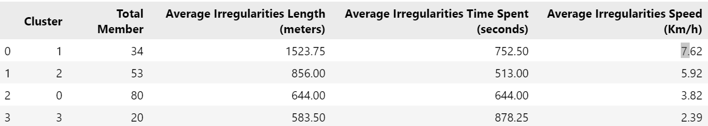
Cluster’s Characteristics
The characteristics of each cluster can be observed and analyzed through the table presented below

Slide 37
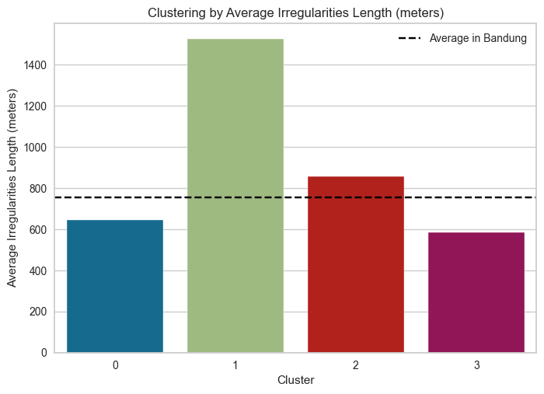
Cluster’s Average Irregularities Length
Based on the average Irregularities Length, only Cluster 1 and Cluster 2 can exceed the overall average in Bandung. This finding suggests that these two clusters may have distinct characteristics and represent areas with higher road irregularities or poor road conditions.

Slide 38
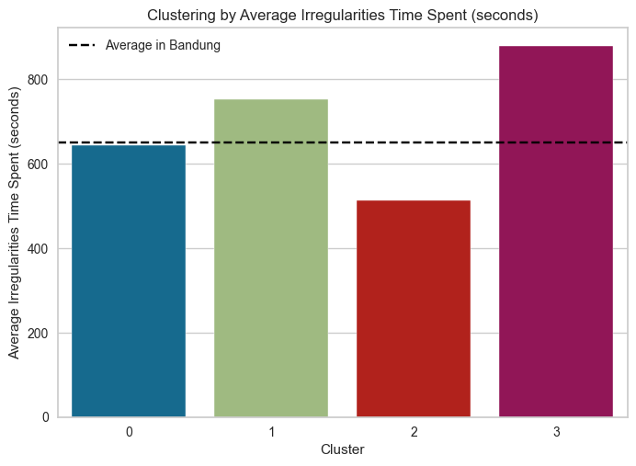
Cluster’s Average Irregularities Time Spent
Based on the average Irregularities Time Spent, only Cluster 1 and Cluster 3 can exceed the overall average in Bandung. This finding suggests that these two clusters may have distinctive travel patterns and preferences compared to the other clusters and may represent areas with longer travel times or congestion during peak hours.

Slide 39
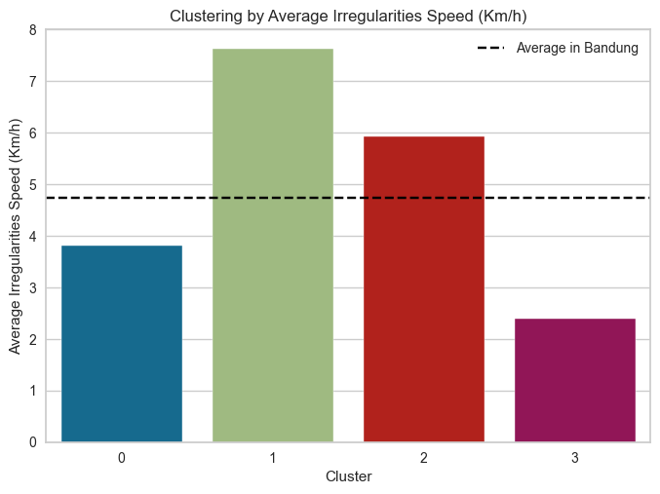
Cluster’s Average Irregularities Speed
Based on the average Irregularities Speed, only Cluster 1 and Cluster 2 can exceed the overall average in Bandung. This finding suggests that these two clusters may have distinct traffic characteristics and flow patterns compared to the other clusters and may represent areas with higher traffic congestion, bottlenecks, or accidents.

Slide 40
Summaries & Recommendations
VI

Slide 41
Summaries
Traffic jam is the most frequently reported Alert Type by drivers in Bandung City.
Traffic congestion is severe on Tuesdays, Thursdays, and Fridays and tends to increase between 9 a.m. to 3 p.m.
There are three time periods (July to September 2022) where the trend for each alert report has significantly increased, requiring further diagnostic analysis to determine the causes of the trends.
Only Streets in Cluster 1 and 2 have an average Irregularities Length that exceeds the overall average in Bandung, indicating these clusters may represent areas with higher road irregularities or poor road conditions.
Only Streets in Cluster 1 and 3 have an average Irregularities Time Spent that exceeds the overall average in Bandung, suggesting these two clusters may represent areas with longer travel times or congestion during peak hours and have distinctive travel patterns and preferences compared to the other clusters.
Only Streets in Cluster 1 and 2 have an average Irregularities Speed that exceeds the overall average in Bandung. These clusters may represent areas with higher traffic congestion, bottlenecks, or accidents and have distinct traffic characteristics and flow patterns compared to the other groups.

Slide 42
Recommendations
To manage severe traffic congestion on Tuesdays, Thursdays, and Fridays, stakeholders should consider implementing road network optimization, rerouting, and information dissemination to provide alternative travel options to motorists.
The three time periods where the trend for each alert report has significantly increased require further diagnostic analysis to determine the causes of the trends. This analysis can provide insight into identifying and addressing potential problems, allowing stakeholders to mitigate future effects of similar issues.
Streets in Cluster 1 and 2 may represent areas with higher road irregularities or poor road conditions, necessitating an evaluation of the roads' maintenance and repair needs by local authorities and transport infrastructure providers.
Streets in Cluster 1 and 3 may represent areas with longer travel times or congestion during peak hours. Stakeholders should consider implementing traffic management and control systems to alleviate congestion and improve traffic flow.
Streets in Cluster 1 and 2 may represent areas with higher traffic congestion, bottlenecks, or accidents, necessitating traffic calming measures, road widening, and accident prevention strategies.

Slide 43
References
VII

Slide 44
https://www.kaggle.com/code/prashant111/k-means-clustering-with-python/notebook
https://towardsdatascience.com/elbow-method-is-not-sufficient-to-find-best-k-in-k-means-clustering-fc820da0631d
https://www.kaggle.com/code/shrutimechlearn/step-by-step-kmeans-explained-in-detail
https://pennmusa.github.io/MUSA_801.io/project_8/index.html
https://www.arcgis.com/apps/dashboards/d1ee0d06645b49d5a01e3bad3add4c5a

Slide 45
Thank You!

